Slide 1


AC-GAN
Andrea Arciprete & Daniela Chiavetta

Slide 2
Several studies have shown that GANs work very well and are able to generate high quality images when datasets consist of images characterized by low variability and low resolution. However, GANs are unable to generate images with high resolution when within the dataset there are images characterized by high variability. In this project, it has been shown that by slightly modifying the structure of a GAN, it is possible to generate images with much higher resolution.

Slide 3
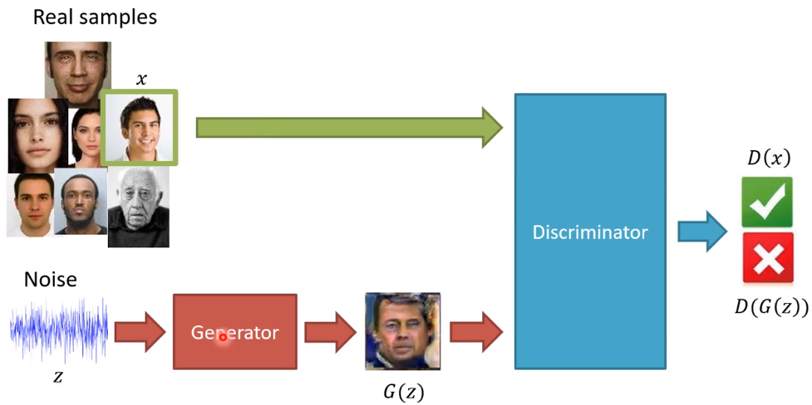
Before going into AC-GAN, let’s briefly resume the Generative Adversarial Networks and the Conditional Generative Adversarial Networks.
GAN
Generative Adversarial Networks, or GANs, are an architecture that allows us to apply the so-called Image Generation.
The architecture is composed of both a generator model that takes random points from a latent space as input and generates images, and a
discriminator for classifying images as either real (from the dataset) or fake (generate).

Slide 4
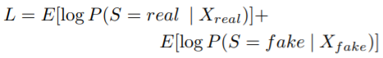
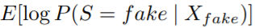
The discriminator is trained in order to maximize the log-likelihood of the discriminator. The discriminator’s log-likelihood makes us understand how good the discriminator is at classifying images that are actually fake as fake and images that are actually real as real.
The generator is trained in order to minimize the log-likelihood of the generator. The generator’s log-likelihood makes us understand how good the generator is at generating images as real as possible.

Slide 5
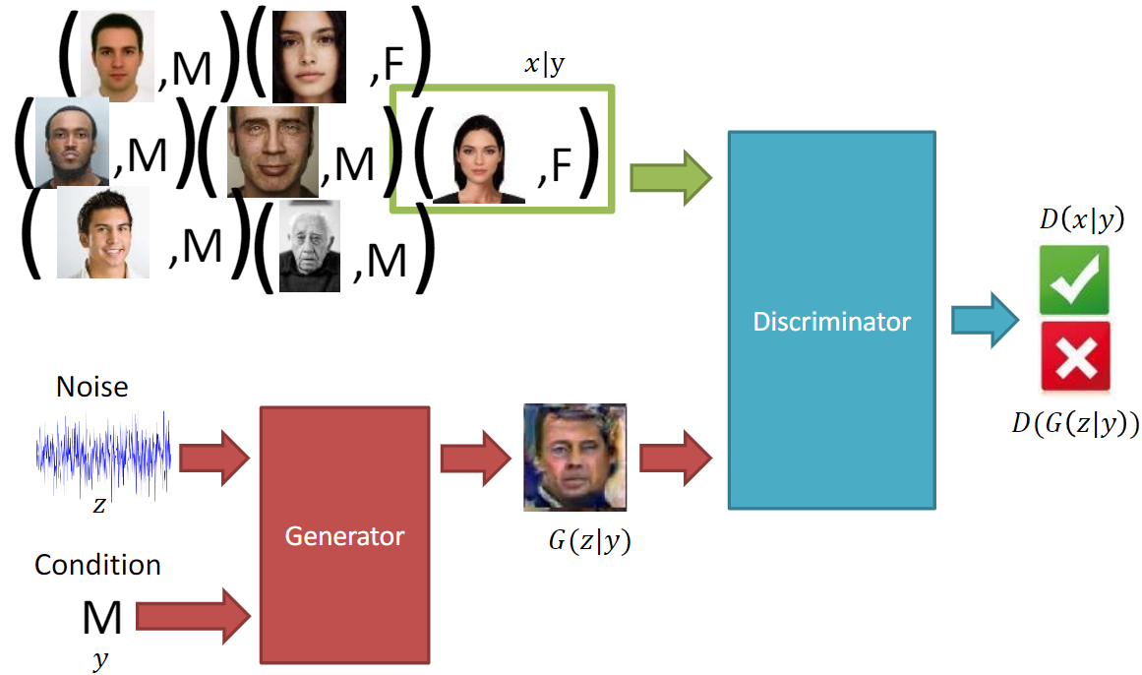
CGAN
A variant of traditional GAN is called CGAN.
The main difference between a GAN and a CGAN is the following: in a GAN, the generator learns how to generate images having a distribution that is acquired automatically by the generator. In a CGAN, the generator learns how to generate images with a distribution that is established by us. In other words, through the use of a CGAN, we can guide the generator to generate images belonging to classes we have decided.

Slide 6

Another variant that has been studied in depth within our project and which allows us to generate images with an even higher resolution is called AC-GAN.
AC-GAN
An AC-GAN is an extension of the CGAN as it provides the same generator as a CGAN but a slightly different discriminator. While the discriminator of a CGAN receives both the image coming from the generator or dataset and the target (real class of the image) and produces the probability that the input image is real and has the correct target, the discriminator of an AC-GAN receives in input only the image coming from the generator or dataset and produces the probability that the input image is real and the probabilities with which the input image belongs to each of the classes. To summarize, in an AC-GAN, the discriminator has to predict the target (real class) of the input image and if the input image is real or fake.

Slide 7
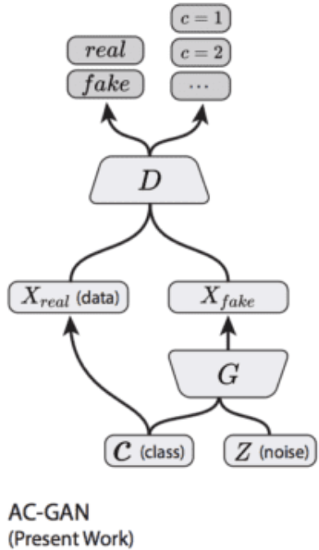

Slide 8
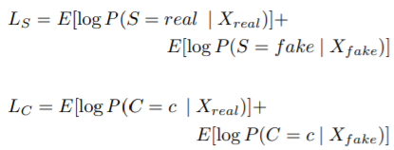
AC-GAN TRAINING
As we have said before, an AC-GAN is made up of two neural networks: a generator and a discriminator. For this reason, we have to train the generator and the discriminator at the same time.
The discriminator is trained to maximize the log-likelihood of the discriminator which gives us an idea of the ability of the discriminator to be able to correctly distinguish between a fake image and a real image and to be able to correctly predict real class of each input image.
The amount that must be maximized during discriminator training is Ls + Lc.

Slide 9
AC-GAN TRAINING
The amount that must be maximized during generator training is Ls + Lc.
The generator is trained to maximize the log-likelihood of the generator which gives us an idea of the generator’s ability to be able to generate images as real as possible.

Slide 10

How does the generator manage to generate a fake image?

Slide 11

As we have said, the generator receives a vector containing random noise and the target (real class of the image that the generator will generate). The generator gradually learns how to associate points that are inside the latent space with the points that are inside the image space. In practice, the generator gradually learns that a certain area of the latent space corresponds to a certain type of image and so on.

Slide 12
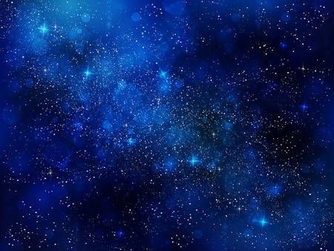
RESULTS FROM THE PAPER
The authors of the article trained several AC-GANs using the ImageNet dataset. The first important result that has been obtained is that by using AC-GAN it is possible to generate high resolution images. The generation of high-resolution images increases the ability of the discriminator to predict the real class of each individual image it receives.
Just to clarify, the fact that the generation of high-resolution images implies an increase in the discriminator's ability to discriminate is valid only if we use an AC-GAN.

Slide 13
RESULTS FROM THE PAPER
If we only want to increase the image resolution, we can use the bilinear interpolation but if we also want to increase the discriminator's ability to discriminate we must necessarily use the AC-GAN.
The authors of the article demonstrated that reducing the image resolution more and more also reduces the ability to correctly predict the class to which the input image belongs.

Slide 14
DEMONSTRATION USING INCEPTION SCORE
To do this, they used the generator of an AC-GAN in order to generate several images with a resolution of 256 x 256. Then, they applied different bilinear interpolations to each single image generated by the generator in order to reduce its resolution. In particular, from each image of size 256x256 they obtained the same image having a resolution of 128x128, the same image having a resolution of 64x64 and so on.

Slide 15
DEMONSTRATION USING INCEPTION SCORE
After that, each of these images was sent in input to an Inception network, already pre-trained using ImageNet dataset.
Then, the Inception output (the prediction related to the class to which each of these images belong) was taken and finally the Inception Score was calculated.

Slide 16
DEMONSTRATION USING INCEPTION SCORE
The authors have seen that images with a lower resolution imply lower Inception Score and a reduced ability of the discriminator to correctly predict the real class to which each image belongs.

Slide 17
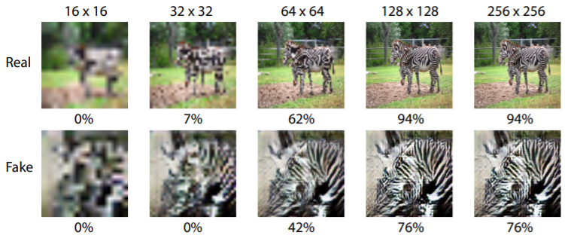

Slide 18

COLLAPSE OF THE GENERATOR

Slide 19
The generator collapses as soon as it is no longer able to generate a variety of different images belonging to the same class but starts to generate always the same images. This is a big problem! If the generator starts to generate the same images, the discriminator very quickly learns how to distinguish between fake images and real images and the model training is stopped very quickly.
It is useful to evaluate the ability of the generator to generate a variety of different images belonging to the same class. To do this, the authors of the article used a metric called multi-scale structural similarity (MS-SSIM).

Slide 20

MS-SSIM
The MS-SSIM is calculated for a certain number of images belonging to the same class and can assume a value between 0 and 1.
More the value of the MS-SSIM is closer to 1, more the images belonging to the same class that are taken into consideration for this calculation are similar to each other.
Because our goal is to make the generator generate a variety of different images belonging to the same class, it is better a MS-SSIM value closer to 0.

Slide 21
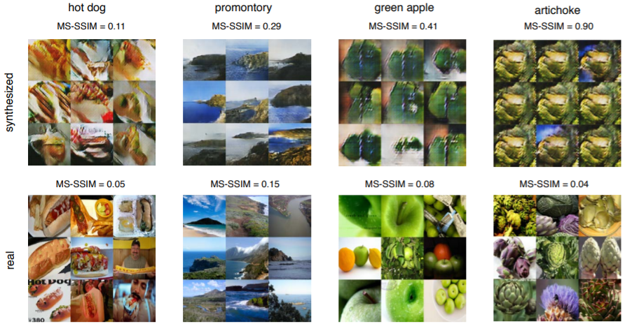

Slide 22
OUR RESULTS

Slide 23
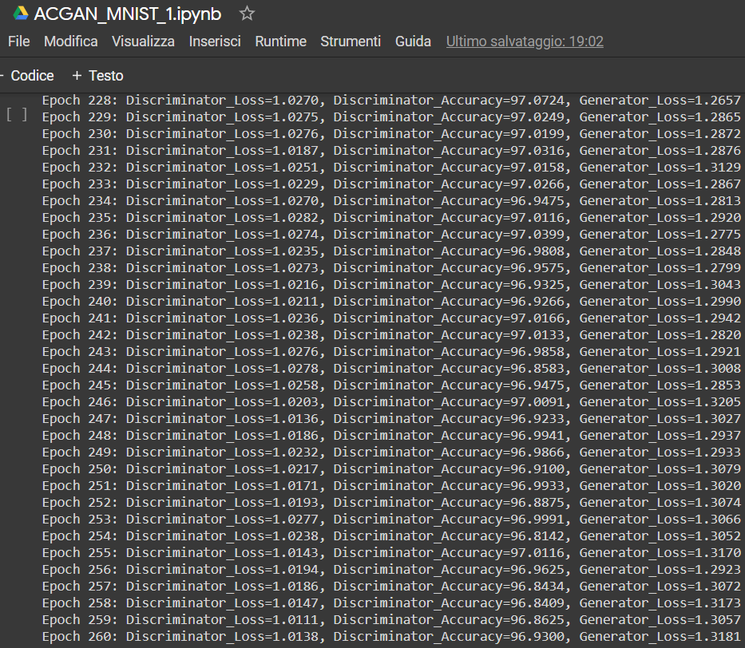
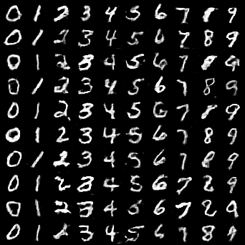
ACGAN-MNIST-1

Slide 24
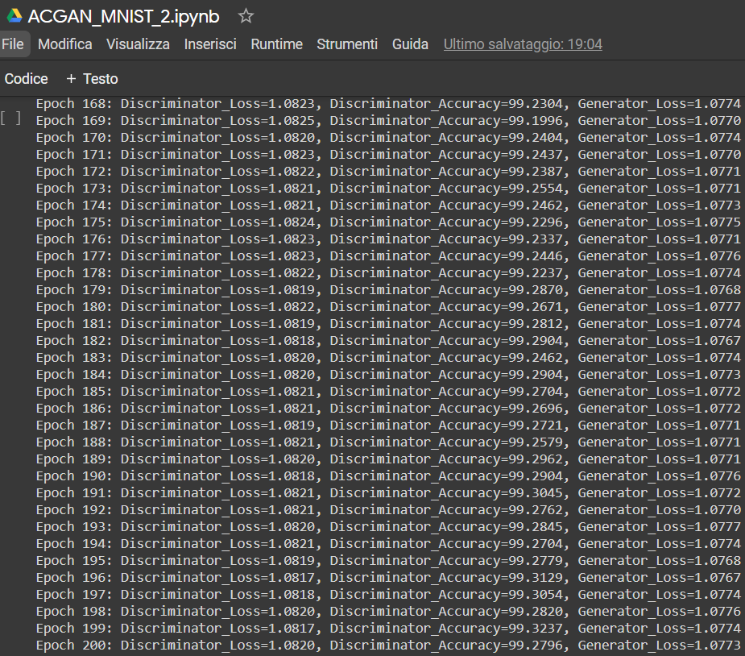
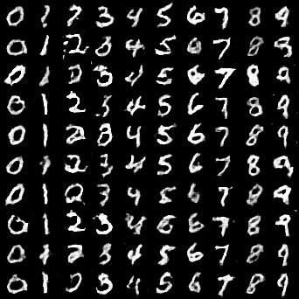
ACGAN-MNIST-2

Slide 25
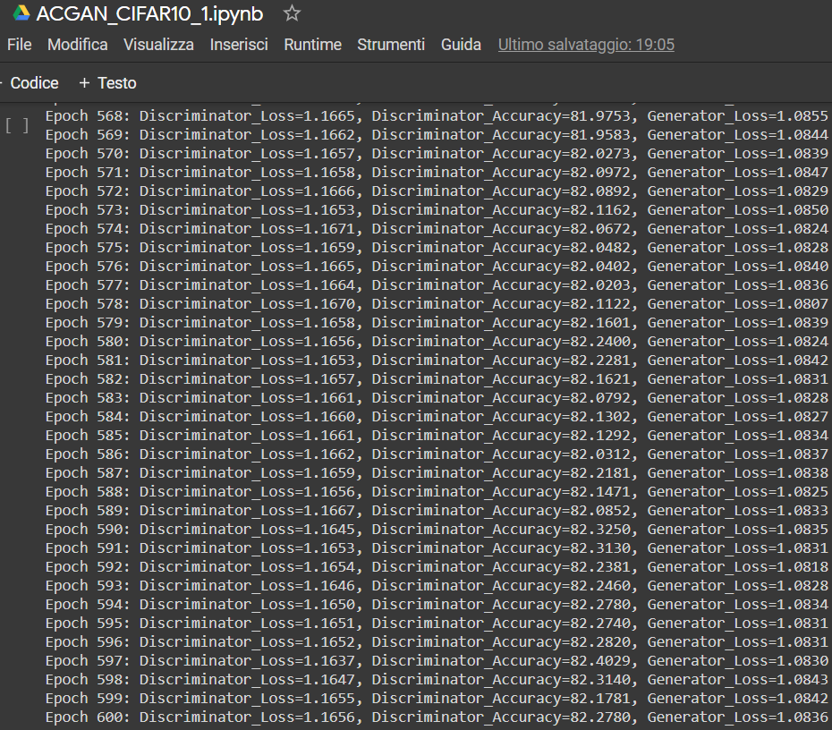
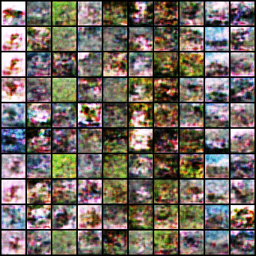
ACGAN-CIFAR10-1

Slide 26
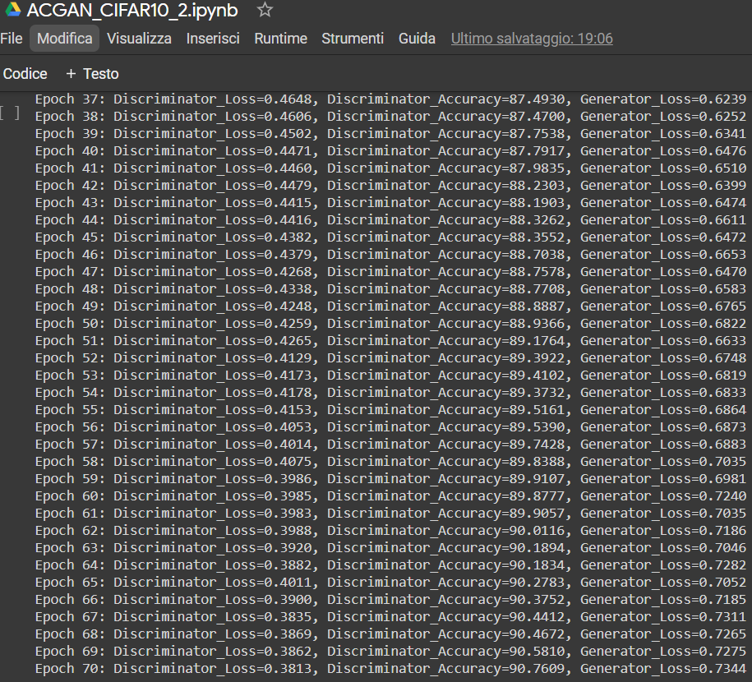
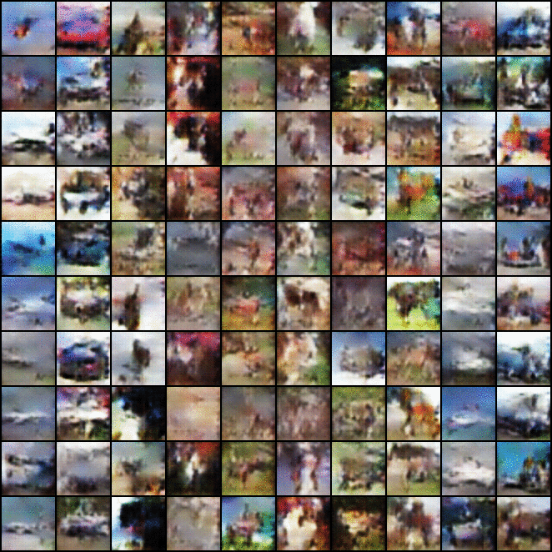
ACGAN-CIFAR10-2

Slide 27
CONCLUSIONS
Thanks to this project, we have understood that by using AC-GANs it is possible to stabilize the training process and generate high resolution images in order to increase the discriminator's ability to discriminate.
Furthermore, we have learnt that by using the concept of Inception Score, it is possible to evaluate the performance of an ACGAN and, in particular, the ability of the discriminator to discriminate.
We have also learnt the existence of a metric called multi-scale structural similarity (MS-SSIM), that can be used to measure the ability of the ACGAN generator to generate a variety of different images belonging to the same class.
Finally, we can say that thanks to this project we have learnt how it is possible to implement and train an ACGAN by using Pytorch.

Slide 28


